Slide 1
Transportation Asset Management: Benefits & Use
Rami Chkaiban
Applied Research Associates, Inc.

Slide 2
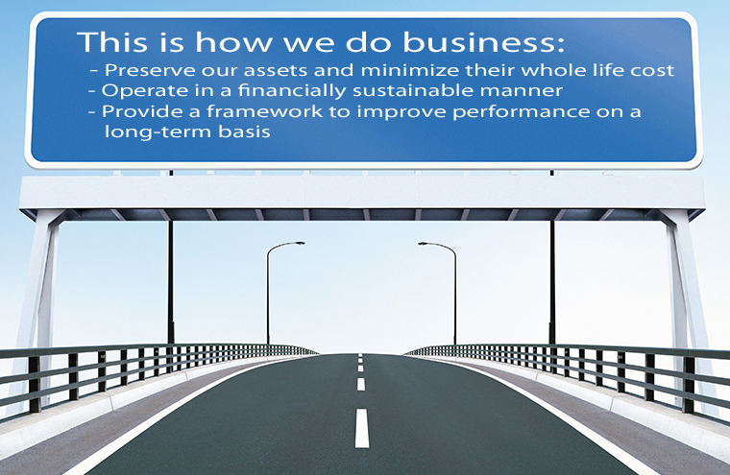
Transportation (Infrastructure) Asset Management
  Asset management is a systematic process of maintaining, upgrading, and operating physical assets cost-effectively.
  It combines engineering principles with sound business practices and economic theory, and it provides tools to facilitate a more organized, logical approach to decision-making.

Slide 3
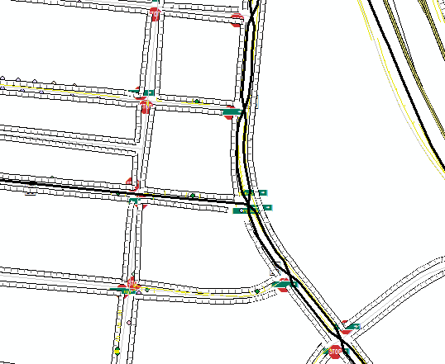
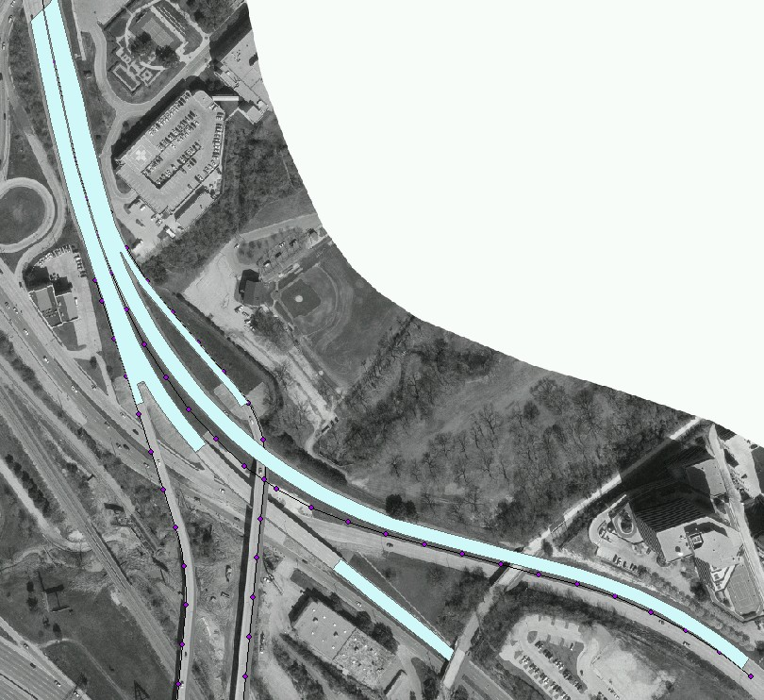
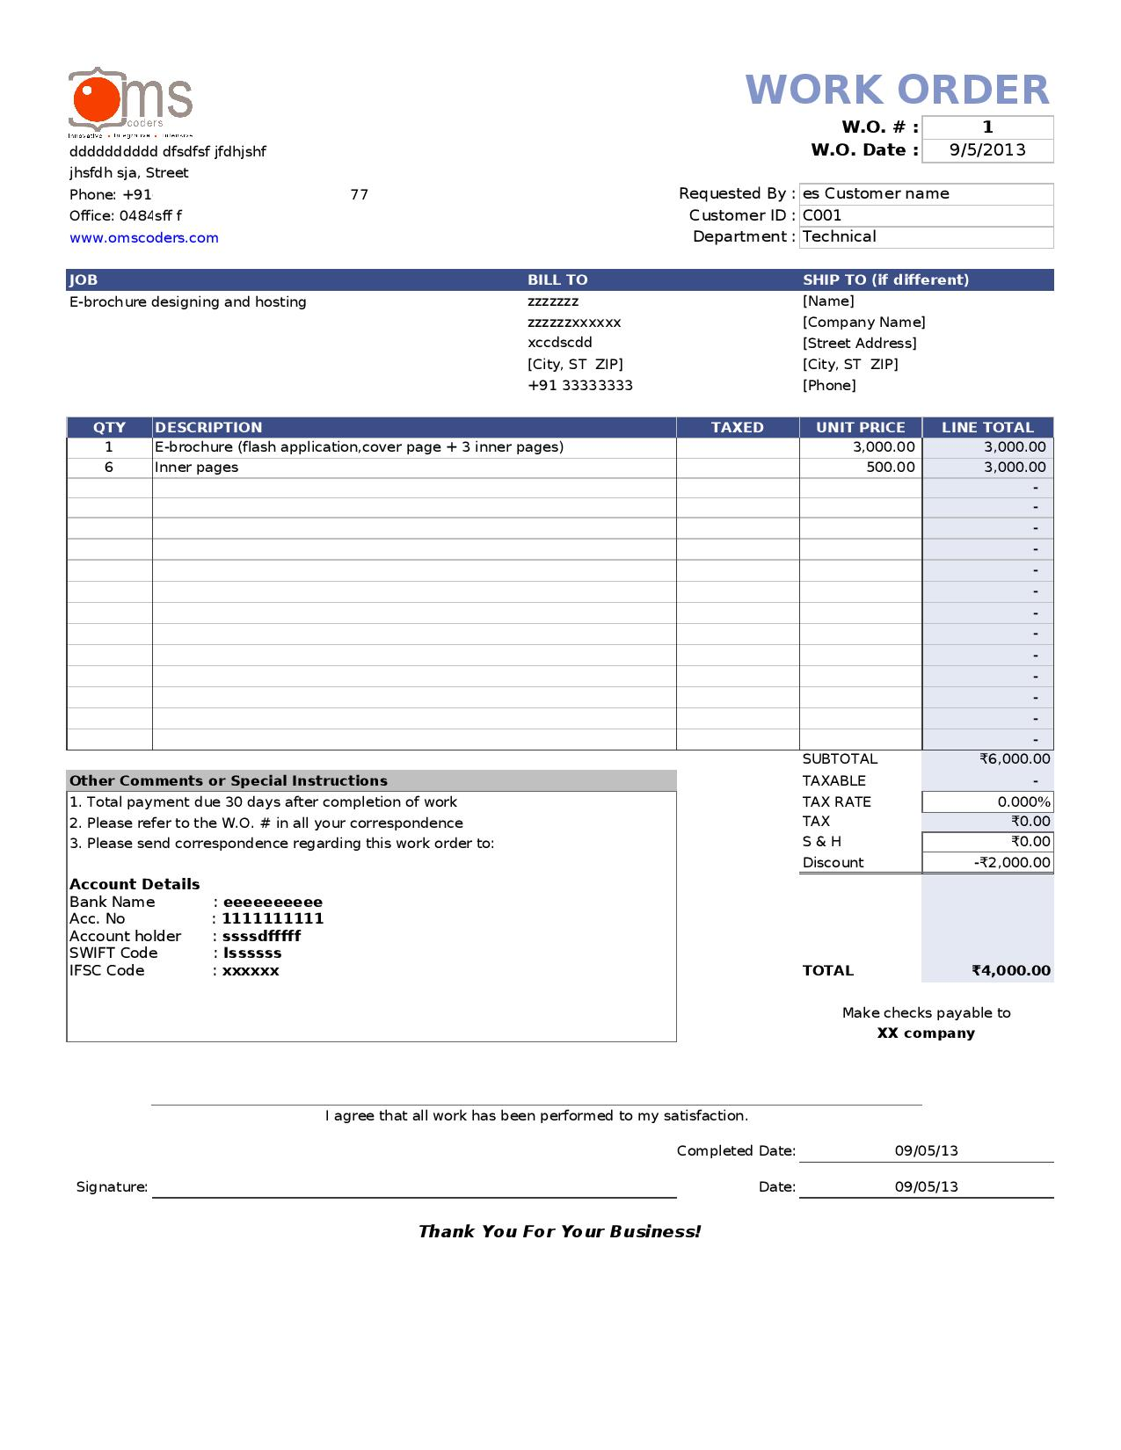
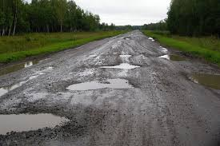
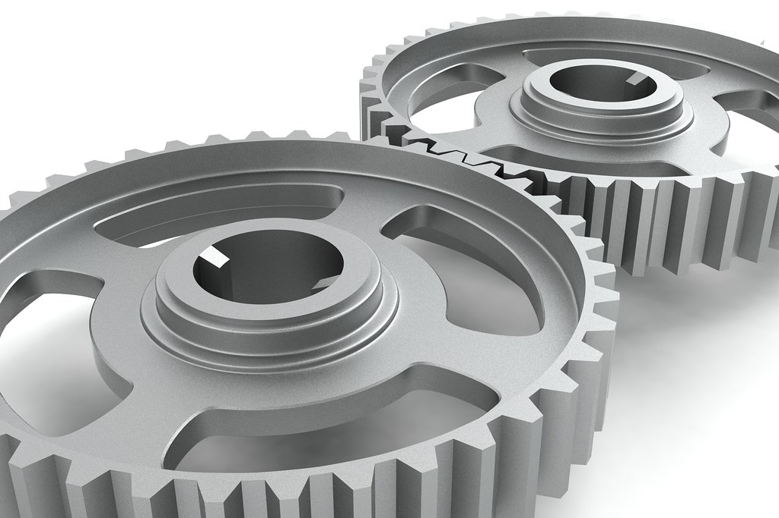
Typical Asset Management Tools
GIS
Inventory
Work Management
Condition Tracking
Analysis

Slide 4
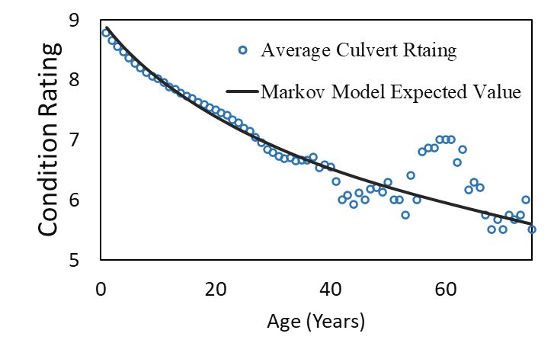
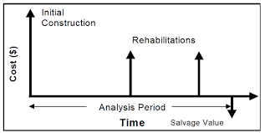
Assess Performance: Life Cycle Planning
  Performance at individual asset level includes a time component.
  Deterioration models can be deterministic or probabilistic.
  Life cycle cost analysis is important for proper economic analysis and investment strategies.

Slide 5

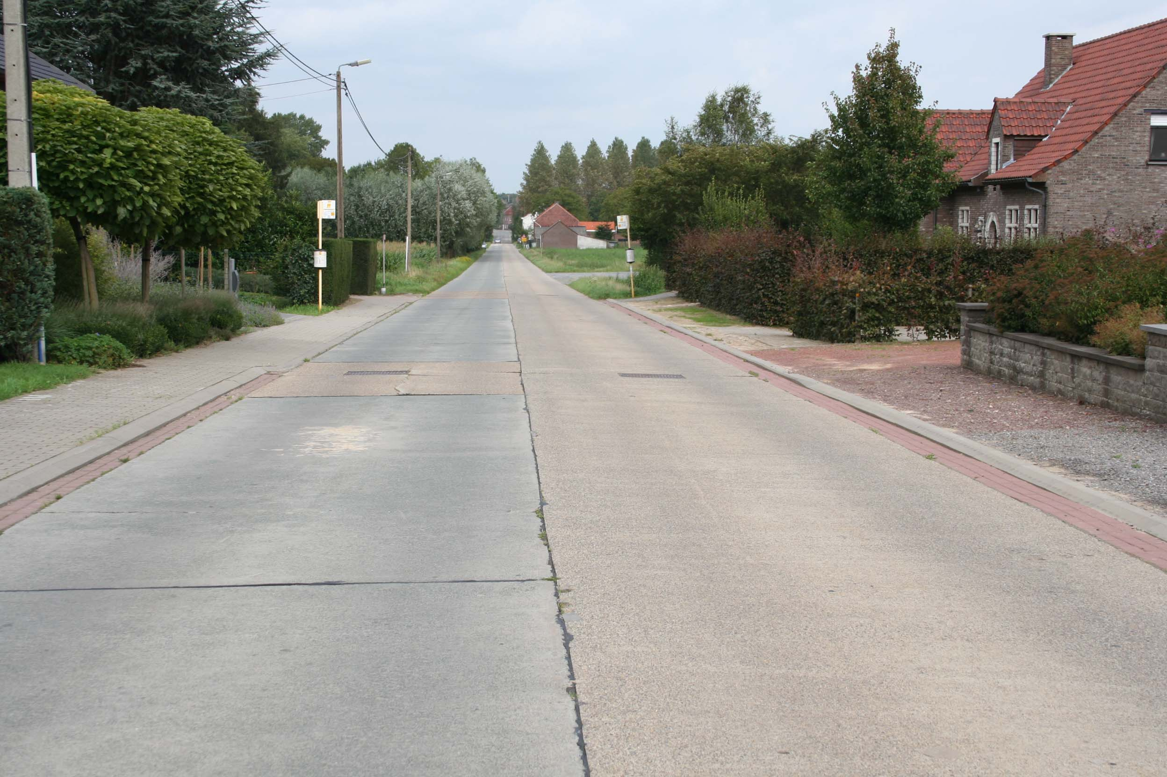
Assess Performance: Life Cycle Planning (Example)
A classic example
Pavement surface condition
Will these deteriorate in the same way? No. The materials are different.
This Photo by Unknown Author is licensed under CC BY-SA

Slide 6
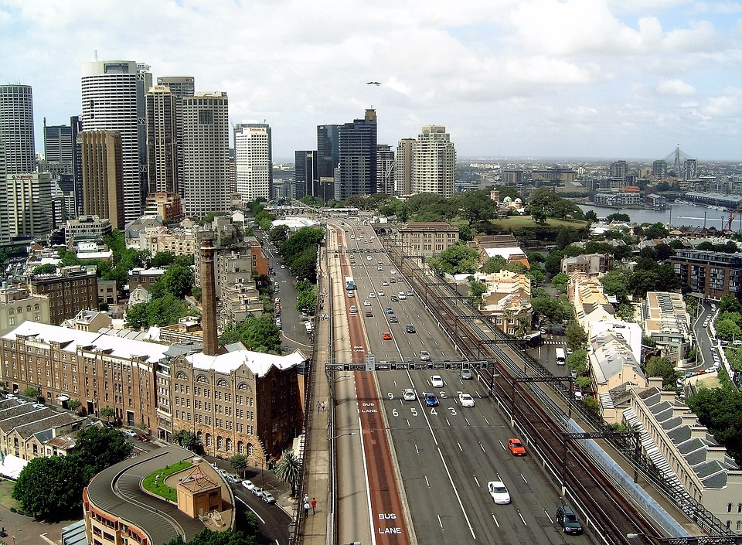
Assess Performance: Life Cycle Planning (Example)
A classic example
Pavement surface condition
Will these deteriorate in the same way? No. The traffic is different.

Slide 7


Assess Performance: Life Cycle Planning (Example)
A classic example
Pavement surface condition
Will these deteriorate in the same way? No. The climate is different.

Slide 8
Assess Performance: Life Cycle Planning
  A performance family is a group of assets where an attribute is expected to perform in the same manner.
  From the example above:
  Asphalt expressways
  Concrete expressways
  Asphalt arterials in warm climates
  Asphalt arterials in cold climates
  Asphalt local roads in warm climates
  Asphalt local roads in cold climates

Slide 9
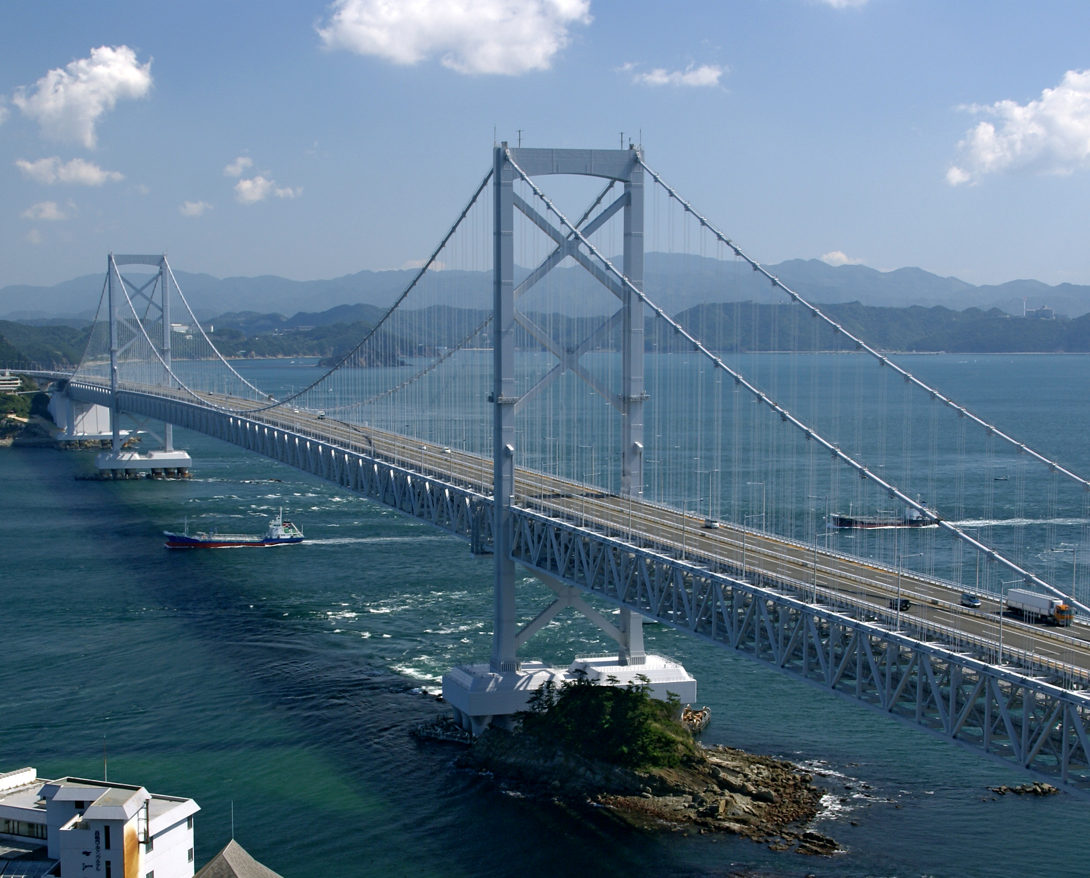
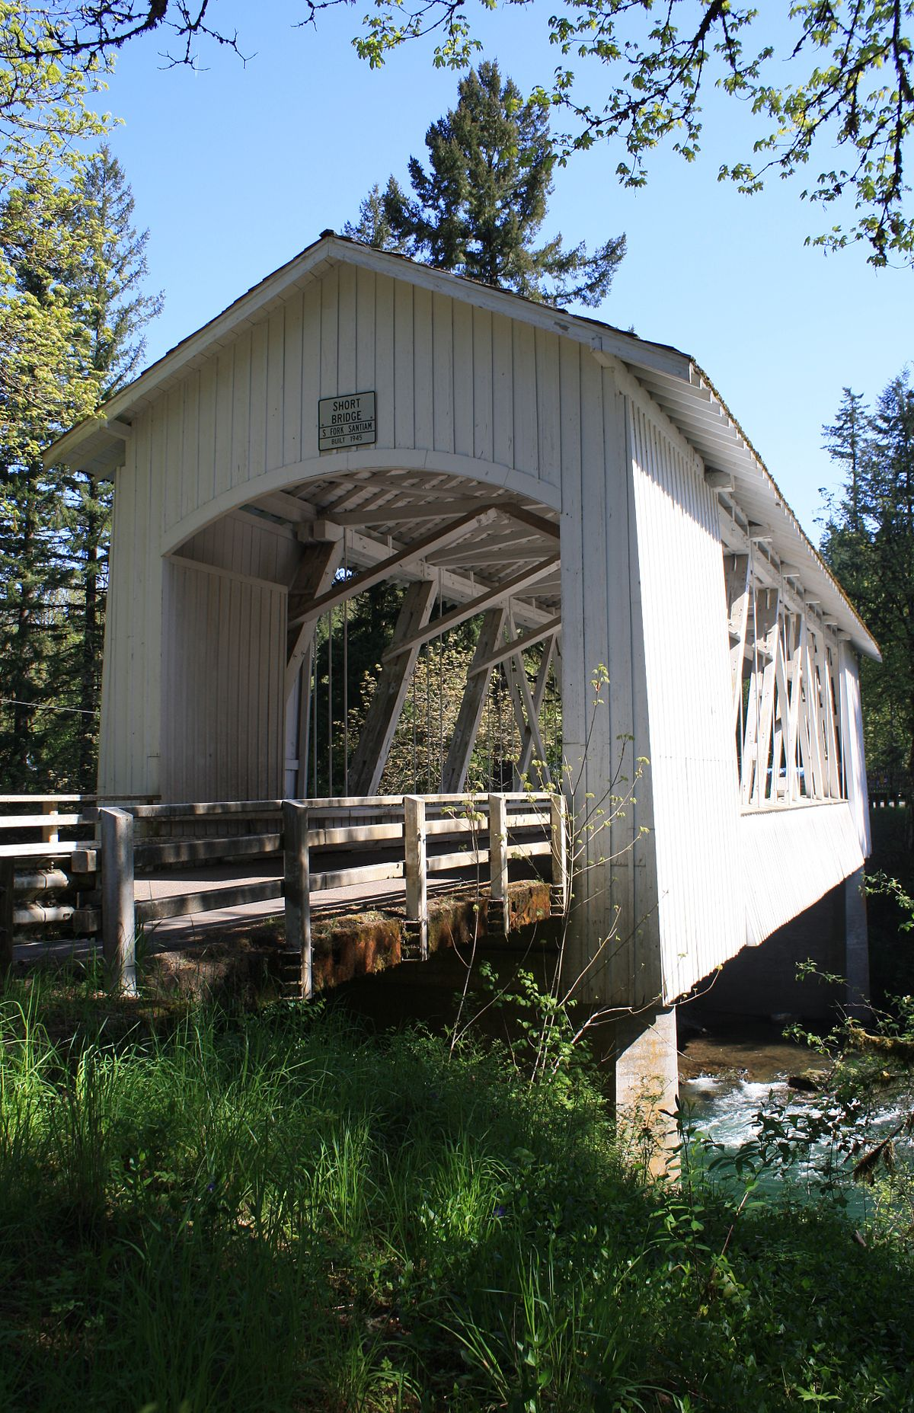
Assess Performance: Life Cycle Planning
  Performance Families (con’t)
  Long bridges with steel superstructures
  Short wood bridges
  Pipe culverts
  Box culverts
  Signs facing south
  Signs facing west
  Guardrail in wet climates
  Guardrail in dry climates

Slide 10
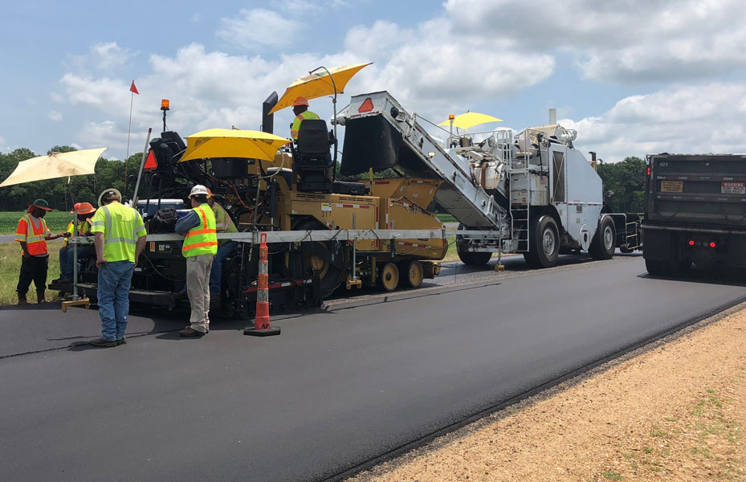
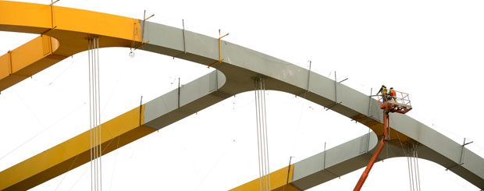
Treatments
Treatments define how assets are improved
  Replacement
  Maintenance (crack sealing, patching, painting)
  Rehabilitation (overlays, sealing, panel replacement, etc.)
They consist of feasibility, consequence/impact, and cost

Slide 11

Asset Management has many benefits
  Improve confidence in selecting the right activity at the right time
  Reduce costs and/or increase efficiency of maintaining network condition within budget
  Consider the feasibility and benefits of applying new strategies (i.e., preservation, recycling)
  Quickly and accurately summarize current and historical condition and future network needs
  Utilize state and federal funding assistance more freely within current operations
  Assets degrade overtime leading to serviceability and other limit state failures (strength and extreme) that cause major injuries, property losses, service interruption, and economic burdens on agencies.
  Challenge: AM is being applied to limited number of transportation assets.

Slide 12
Treatments happen at different conditions
Rejuvenator, Minor repair
(PCI + 5)
Crack Seal & Microsurface
(PCI + 20%)
Minor Rehab
(PCI = 100)
Reconstruction/ Major Rehab
(PCI = 100)
“Bang for the Buck”
Early for Surface Treatments
Defer for Overlays (but not too long!)

Slide 13
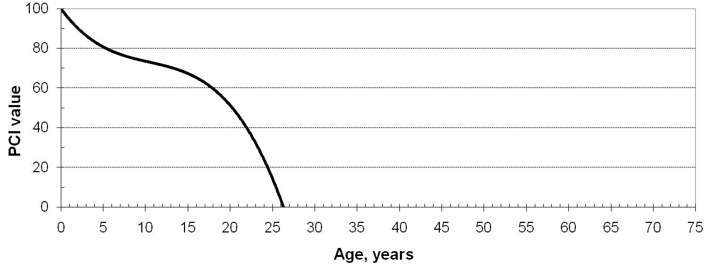
Reduce Costs and/or Increase Efficiency Example
Major Rehabilitation
$375,000 / mile
“Worst-First”
Extends life 22 years
Distress Repair
$10,000 / mile
Surface Treatment
$50,000 / mile
Surface Treatment
$50,000 / mile
Minor Rehabilitation
$250,000 / mile
Prevent. Maint.
Extends life 45 years
Total M&R Cost = $360,000 / mile
* Representative costs in initial year USD; no inflation or discounting

Slide 14
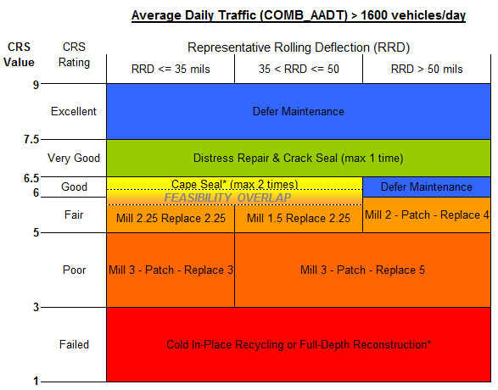
Treatment matrix promotes good decisions
“Picking the right treatment for the right road at the right time!”

Slide 15
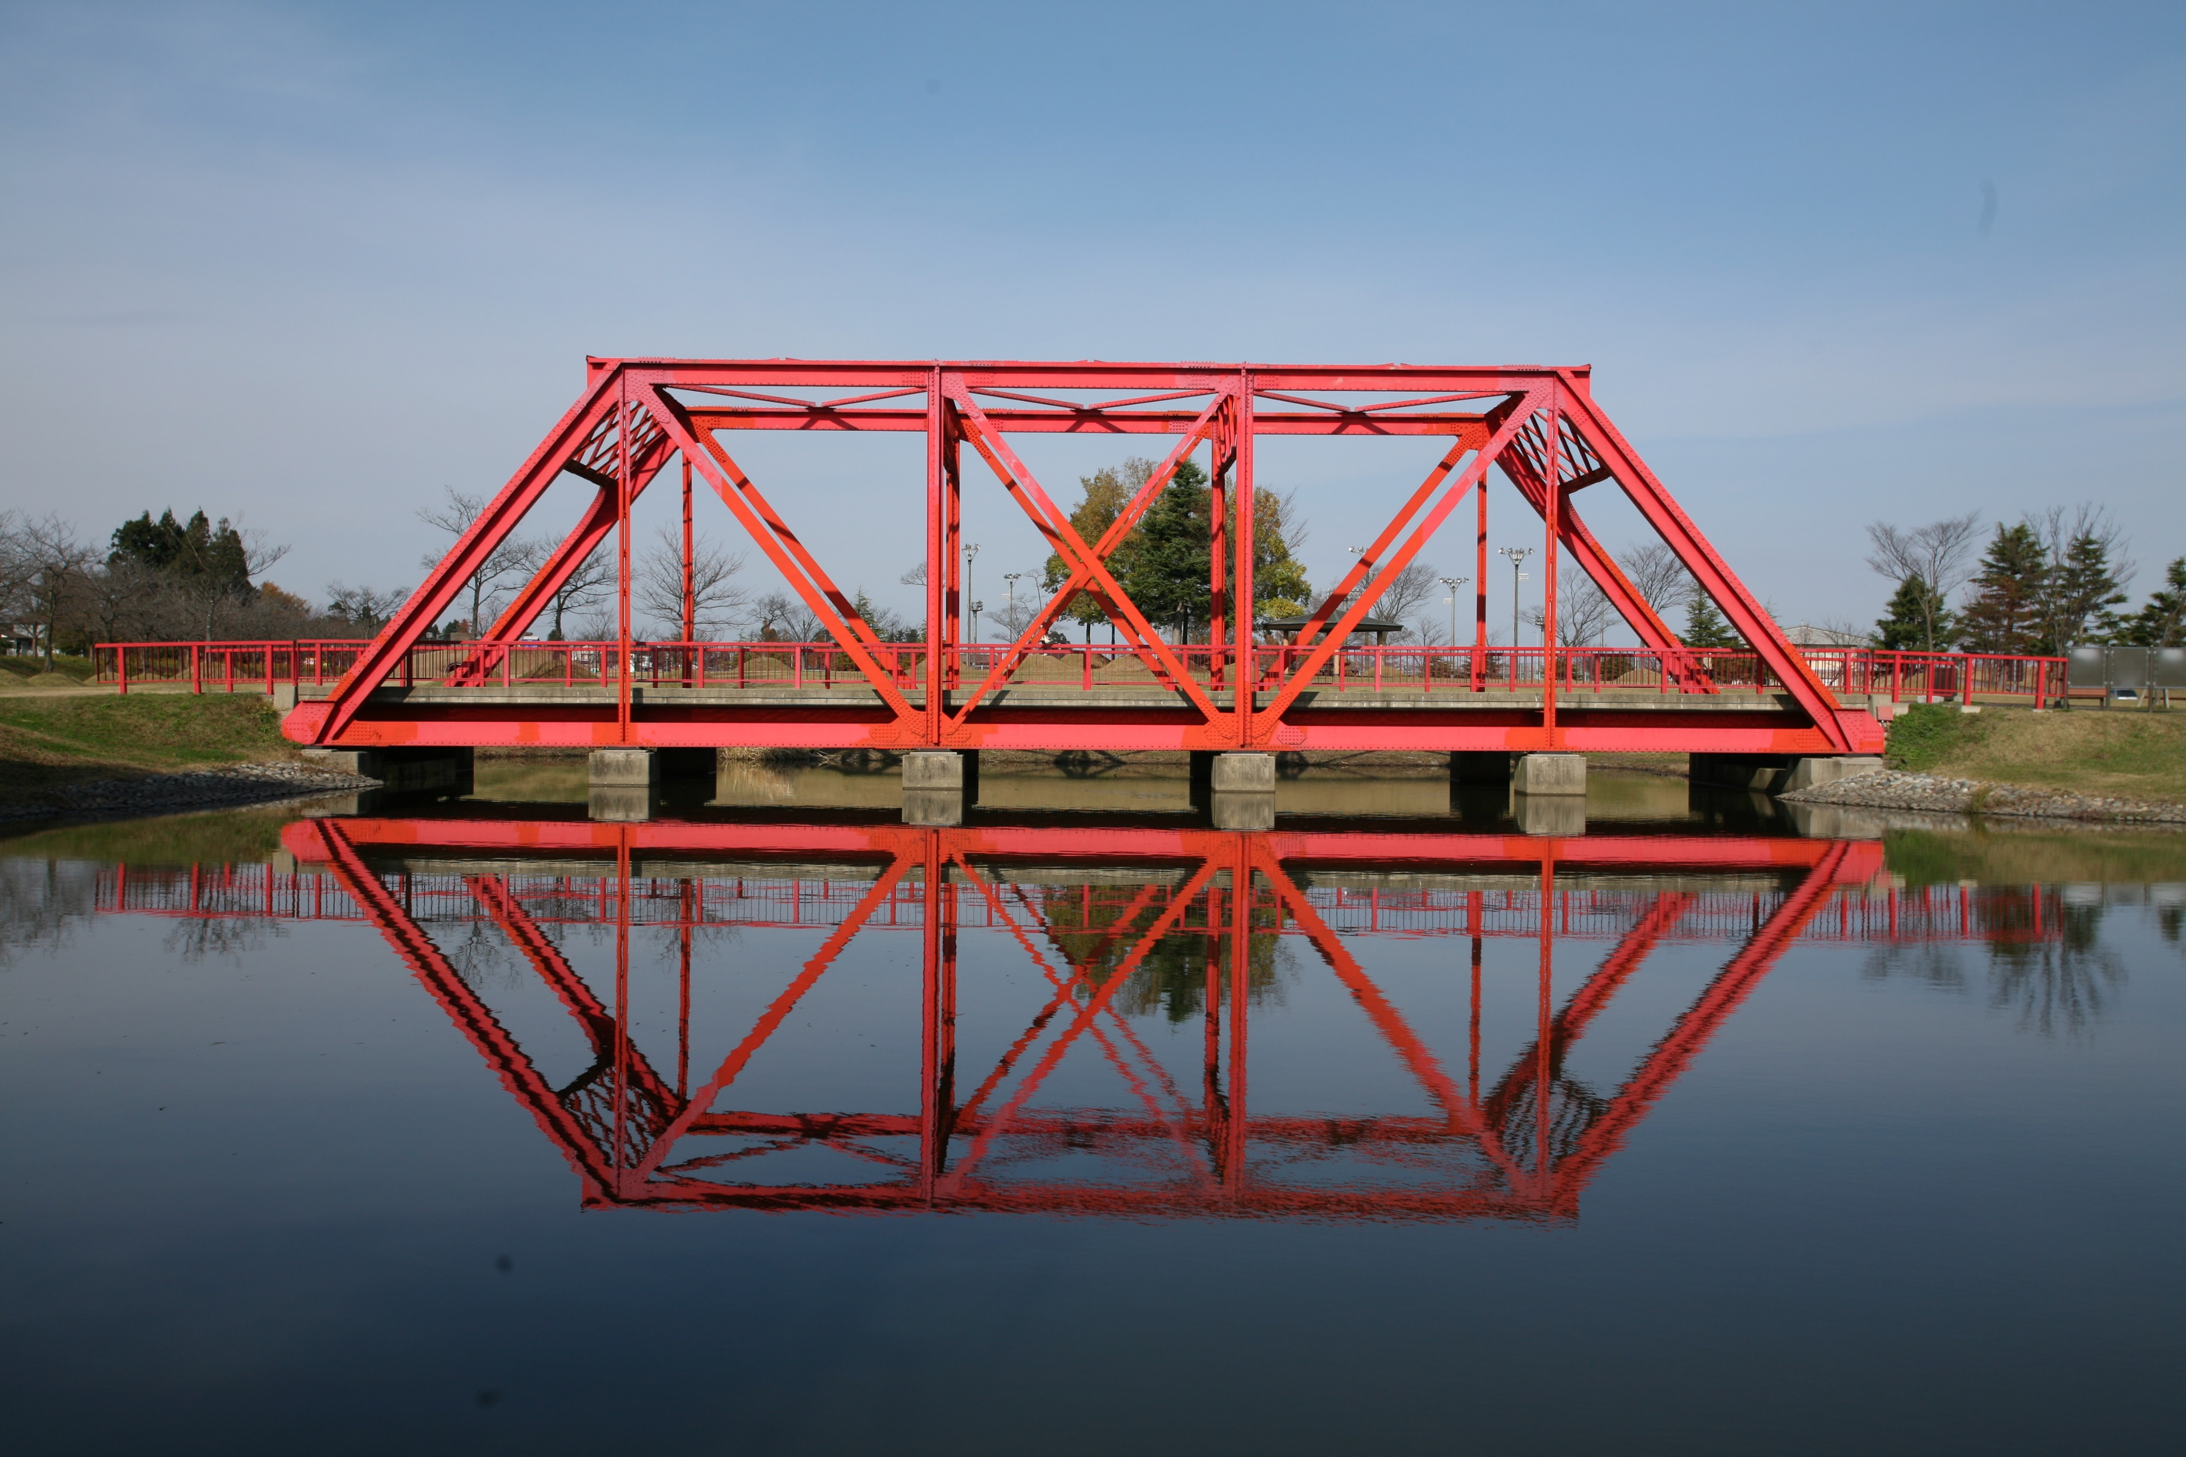
Bridge Asset Management
Color
Type
Length
River Name
投稿者, CC BY-SA 3.0 <https://creativecommons.org/licenses/by-sa/3.0>, via Wikimedia Commons

Slide 16
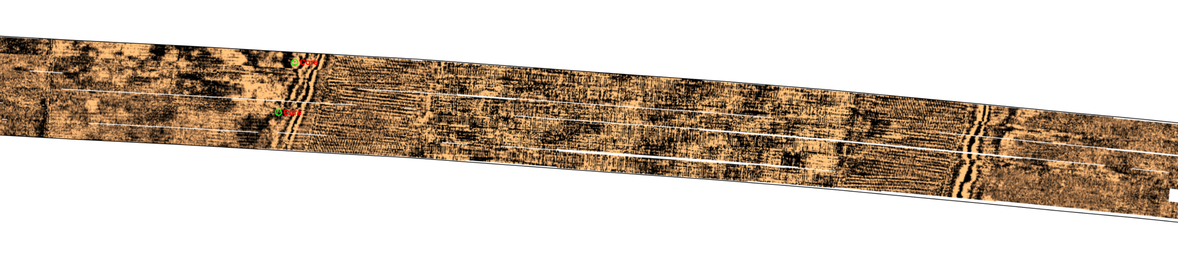
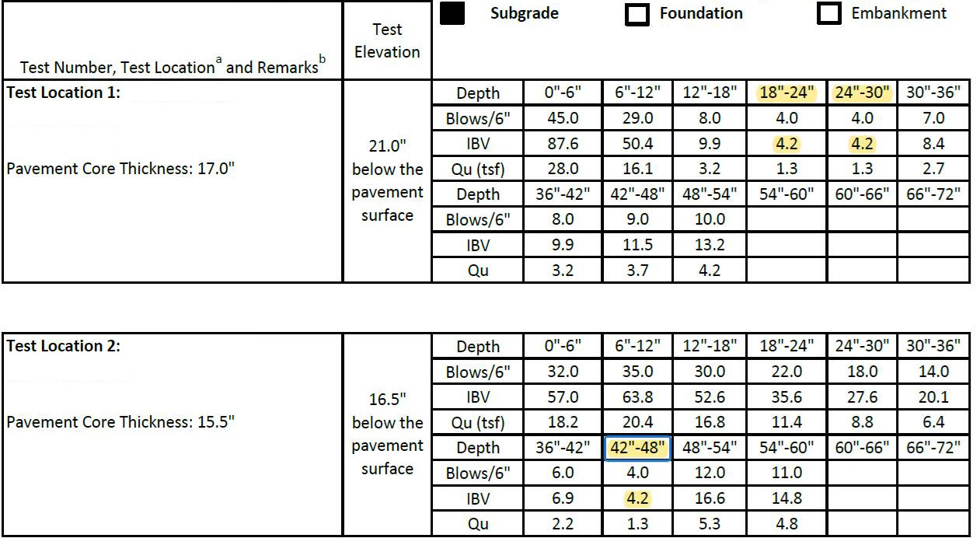
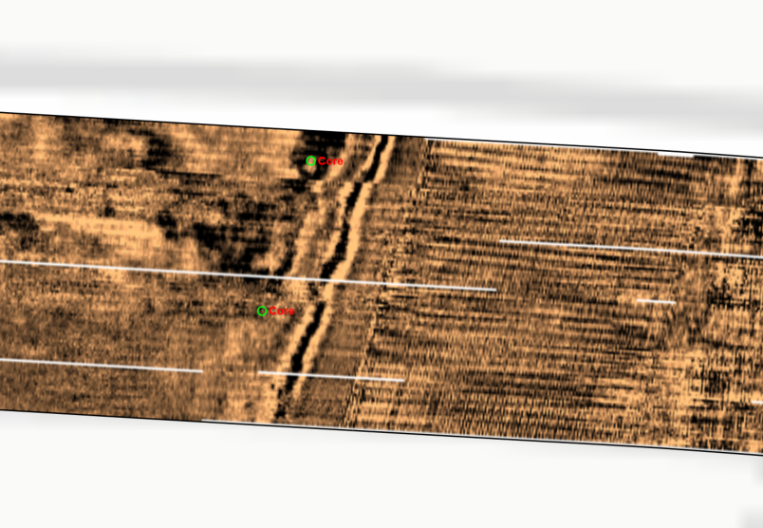
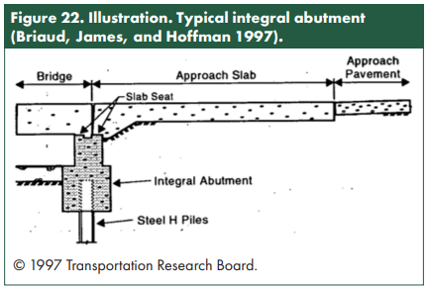
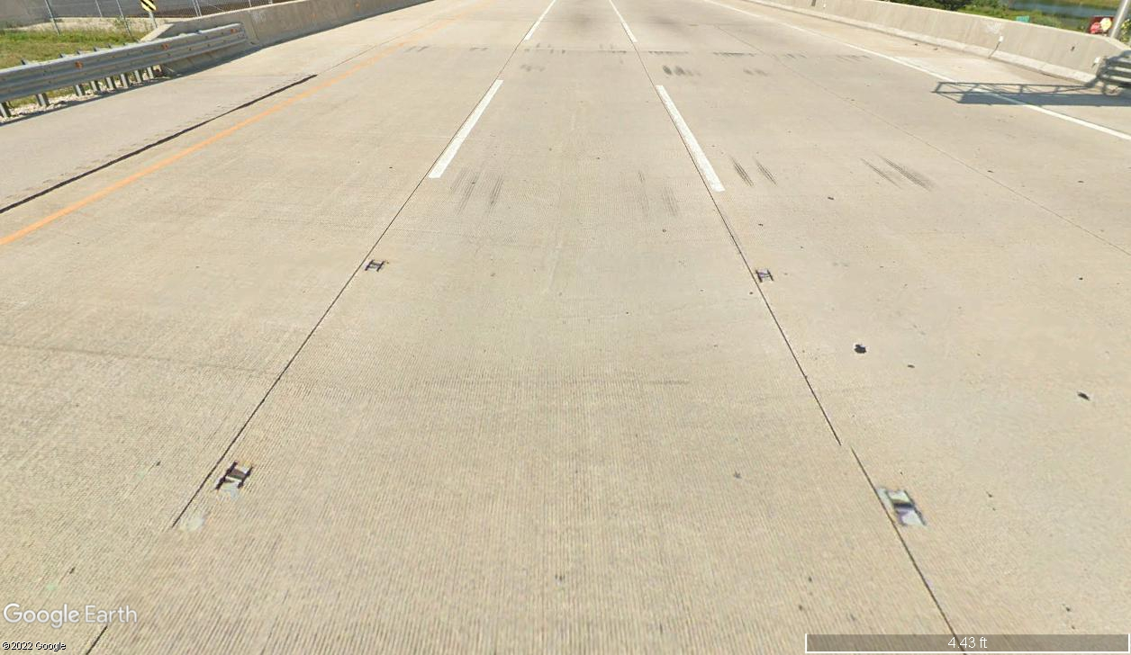
Asset Management Bridge Approaches

Slide 17
Where does TAM stand?
  The focus has been on pavements and bridges for the physical assets.
    What about other assets?
  What About Geotechnical Assets?

Slide 18
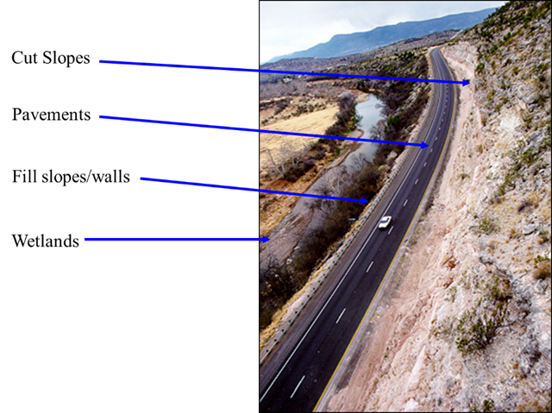
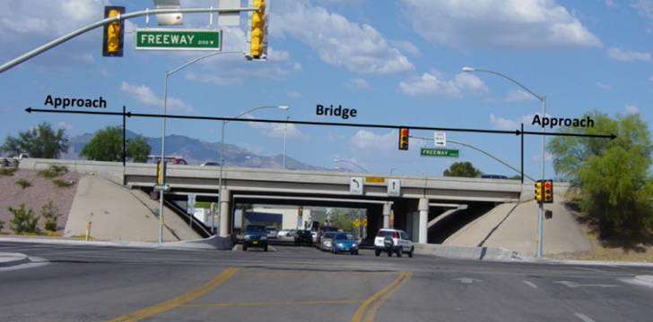
Which Geotechnical Assets?
  Geotechnical assets can include earth retaining structures, embankments, slopes, foundational elements, tunnels, culverts of other transportation assets.
  The term geotechnical feature could apply to all infrastructure features constructed on, in, or of soil and rock [NCHRP 20-126(3)].
Source: Naresh Samtani

Slide 19
Benefits of GAM
  Geotechnical assets have typically been handled as permanent assets with unlimited service life.
  Experience shows that these assets degrade overtime leading to serviceability and other limit state failures (strength and extreme) that cause major injuries, property losses, service interruption, and economic burdens on agencies.
  Geotechnical Asset Management (GAM) programs reduce life-cycle costs, reduce performance and operational disruptions, and lead to fewer emergency stabilization projects.

Slide 20
The GAM process
Define and Locate Assets
Assess Assets Condition
Assess Performance
Conduct Investment Analysis
Communicate Results
Incorporate Process Improvement
  GAM includes several components and the agencies’ focus can vary.
  Generally, a GAM program includes multiple steps and requires an iterative and cyclic to improve and refine the program throughout its implementation.
Implementation steps, NCHRP Project 24-46

Slide 21
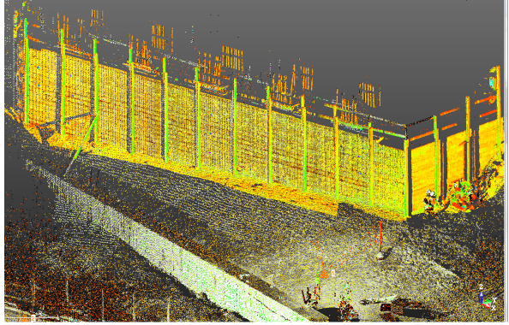
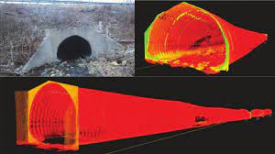
Asset Inventory and Condition: Defining and Locating Assets
  Need to identify the asset type and the size of the assets to be included in a GAM.
  Currently, most agencies do not have the assets in a single database.
  Remote sensing, geophysical technologies, and other sensors can facilitate the process.
A Alhasan, MP McGuire, PKR Vennapusa, DJ White. (2016)
Mickel, H. B., & Hagert, J. R. (2016)

Slide 22
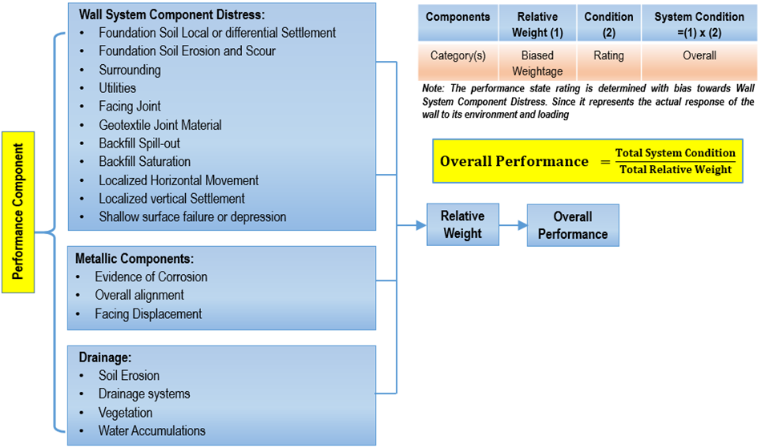
Asset Inventory and Condition: Assess Assets Condition (1 of 2)
  Unlike other transportation assets such as pavements and bridges, geotechnical assets do not have clear definitions of homogenous condition indices or measurements.
  Condition assessment has mainly focused on the ultimate limit state.
  Homogenous Performance metrics should account for ultimate and serviceability limit states.
Example of performance assessment framework for MSE walls

Slide 23
Asset Inventory and Condition: Assess Assets Condition (1 of 2)
  Unlike other transportation assets such as pavements and bridges, geotechnical assets do not have clear definitions of homogenous condition indices or measurements.
  Condition assessment has mainly focused on the ultimate limit state.
  Homogenous Performance metrics should account for ultimate and serviceability limit states.
Example of performance assessment framework for MSE walls

Slide 24
Remarks
  GAM programs are at a very early stage and still not considered by all agencies.
  GAM is a tool to improve planning and should not be considered as a burden.
  There is a lot to be learned and improved from other established TAM programs.
  Geotechnical assets are unique due to their heterogeneity and their uncertainty should be handled properly through robust models and techniques.

Slide 25
Key Points Towards Multimodal Asset Management System
  Cannot emphasize enough how important is communication and coordination.
  AM programs serves multiple groups and a wide range of purposes.
  Summarizing data-driven findings properly are the most critical to support decision makers.
  Understanding the challenges with the decision-making process is critical to have a realistic decision support tools

Slide 26
Questions?
Rami Chkaiban
Senior Engineer email: rchkaiban@ara.com | Phone: 775-247-4343

